Slide 1

Olap tools
Ibm cognos
vs
sisense
Sango Fon

Slide 2
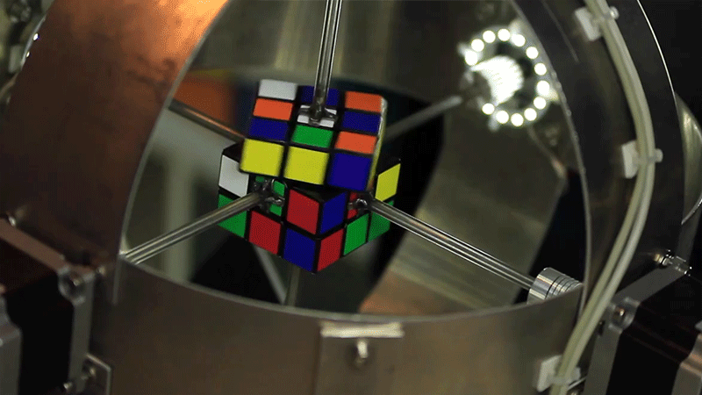
agenda
Brief Summary of OLAP
OLAP Products
ROLAP (Relational Online Analytical Processing)
MOLAP (Multidimensional Online Analytical Processing)
HOLAP (Hybrid Online Analytical Processing)
Selected OLAP Tools
IBM Cognos
Sisense
Evaluation Criteria
How do the respective platforms deal with multidimensional dataset "Cube"
Performance (Query & Storage)
Security
Costs
Usability & Major limitations
Comparative Summary table for both tools
Conclusion
" T h e c u b e "

Slide 3
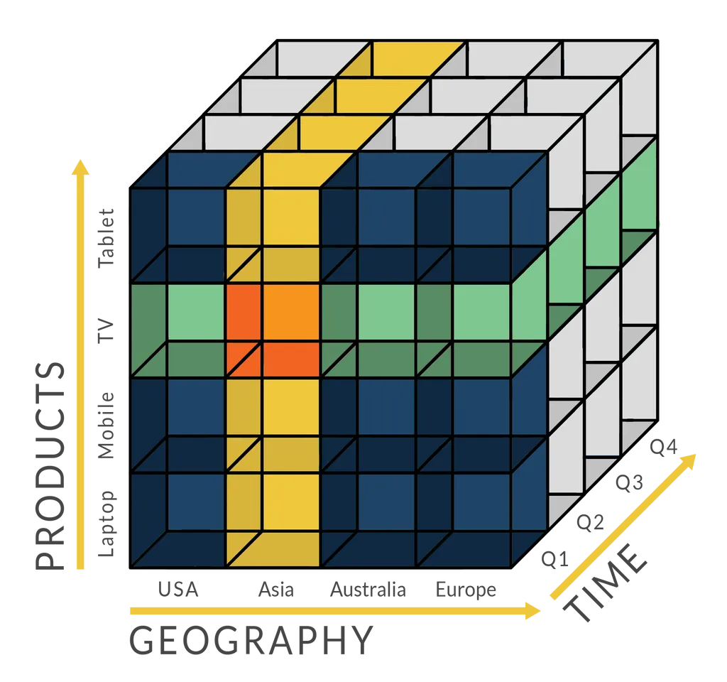
Brief overview of oLAP (Online Analytical Processing)
"The Technology behind the majority of BI tools"
Helps to run:
Multi-dimensional analytical queries
Analyzes + presents data with different dimensions:
Location
Time
Product
Etc.
DATA WAREHOUSE
Notes:
slicing and dicing, looking at right after analyzes

Slide 4
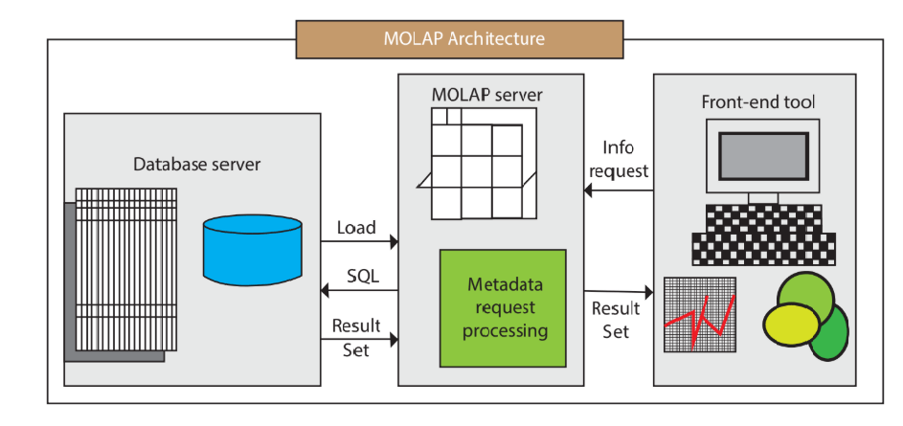
Types of OLAP Include: Molap (Multidimensional Online Analytical Processing)
MOLAP is:
OLAP that indexes directly into a multidimensional database.
MOLAP processes:
Data that is already stored in a dimensional array
All possible combinations of data are reflected, each in a cell
Cells can be accessed directly.

Slide 5
OLAP Tools : IBM Cognos vs Sisense
Evaluations' Criteria
1. How does the tool deals with multidimensional dataset "Cube" or data in General.
2. Performance : Query and Storage performance
3. Security: Policy and Security Architecture
4. Costs: Licencing, Software, Hardware, & installations
5. Usability: Implementation, ease of use, platforms supported

Slide 6
IBM Cognos Overview
IBM Cognos Intelligence is an integrated business intelligence suite that provides a wide range of functionalities to help understand and manage an organization’s data.
Web-based Solution: Both the development and end user viewing happens online
It Supports both ROLAP and MOLAP
It helps to create business reports, analyze data, and monitor events and metrics in order to make effective business decisions

Slide 7
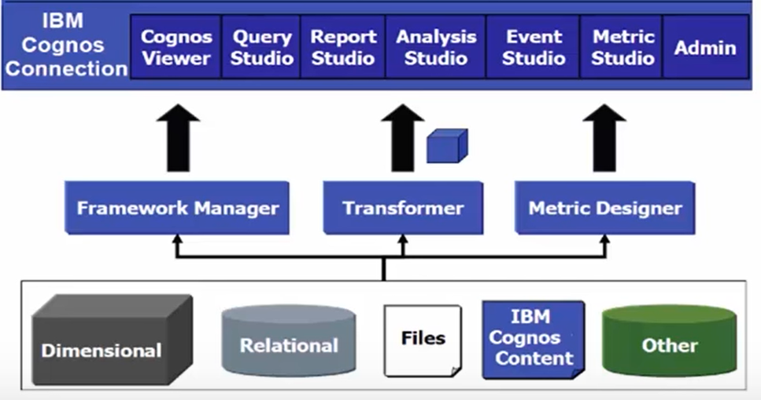
IBM Cognos Business Intelligence Suite
* IBM Cognos Connection
* IBM Cognos Insight
* IBM Cognos Workspace
* IBM Cognos Workspace Advanced
* IBM Cognos Report Studio
* IBM Cognos Event Studio
* IBM Cognos Metric Studio
* IBM Cognos Query Studio
* IBM Cognos Analysis Studio
* IBM Cognos for Microsoft (tm) Office

Slide 8
Criterion 1: How does IBM Cognos deal with multidimensional dataset or data
Cognos TM1 is a MOLAP Technology that can handle medium data volumes
IBM Cognos PowerCubes is a MOLAP technology that uses pre-aggregation of data
Dynamic Cubes: are commonly used for the analysis of large volumes of data. It provides ROLAP capabilities within dynamic query support for both in-database and in-memory aggregates.
Dimensional Modeled Relational (DMR) is an OOT (object-oriented technology) which is used when we need a dimensional advantage in relational data. Also, it can be used for the analysis of the low volume of data.
HOLAP Cognos Solution: Tailored solution based on PowerCubes & Dynamic Cubes:
Data is stored in both multidimensional and relational database.
HOLAP Speedy data retrieval makes it the best for "slicing and dicing"
The setup allows more flexibility for handling data
For heavy Processing data stored in relational database

Slide 9
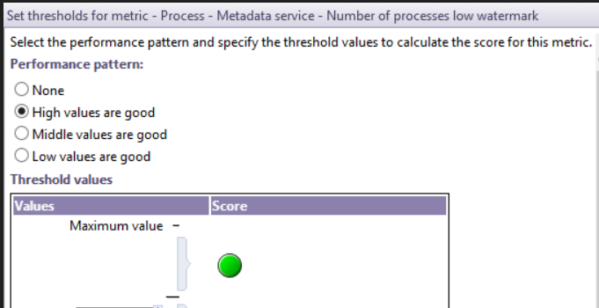
Criterion 2: performance
High-performance data accessibilities crossover all the sources.
Improve scalability by enabling or disabling Content Manager
Metric Studio
Event Studio
Setup performance metrics to monitor each server or a group of servers

Slide 10
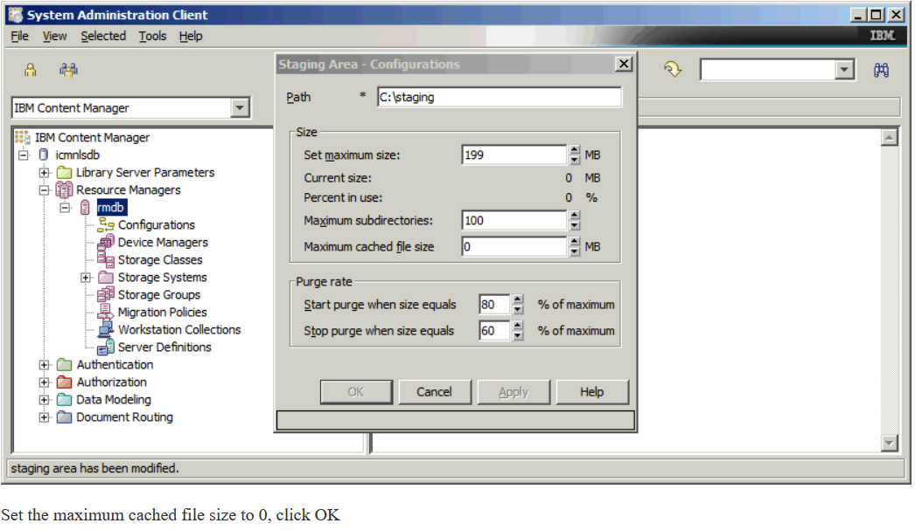
Staging Area

Slide 11
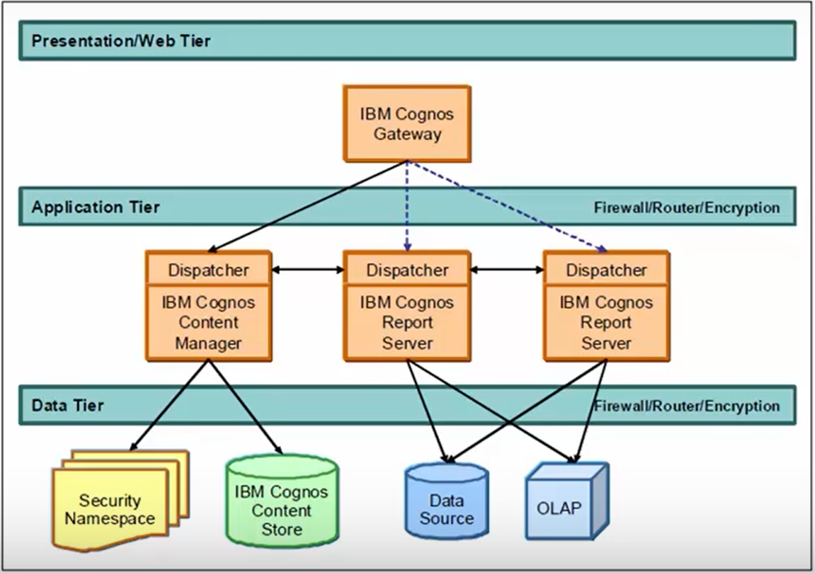
Criterion 3: Security
Application Tier: Content Manager
* Security Settings and Configuration
* Server Configuration Settings
* Package
* Dashboards
* Metrics
* Report Specification
* Report Output
Data Tier
*Content store
*Data source
Metric Store
Content Store: Is a relational database that contains data that Cognos products need to operate

Slide 12
Criterion 4: Average Cost of ownership
Costs vary based on your tailored solution
A workgroup license is $75 per user, per month, with a minimum subscription of 50 users and a minimum six-month term. It is renewed semi-annually with monthly billing.
A standard license is $95 per user, per month, with a minimum subscription of 100 users and a minimum one-year term. It is billed monthly and renewed annually.
An enterprise license is $125 per user, per month, with a minimum subscription of 150 users and a minimum one-year term. It is billed monthly and renewed annually.
Data Migration Costs
There is student subscription via universities that have an agreement with IBM

Slide 13
Criterion 5: IBM Cognos usability & limitations
Usability:
. User friendly interface & Intuitive
. IBM Cognos is accessible through several types of supports (Mobile, Desktop,…)
. Need expert level skillsets to setup enterprise web-based solution
. Excellent documentation
. Availability of free and on-demand paid training materials.

Slide 14
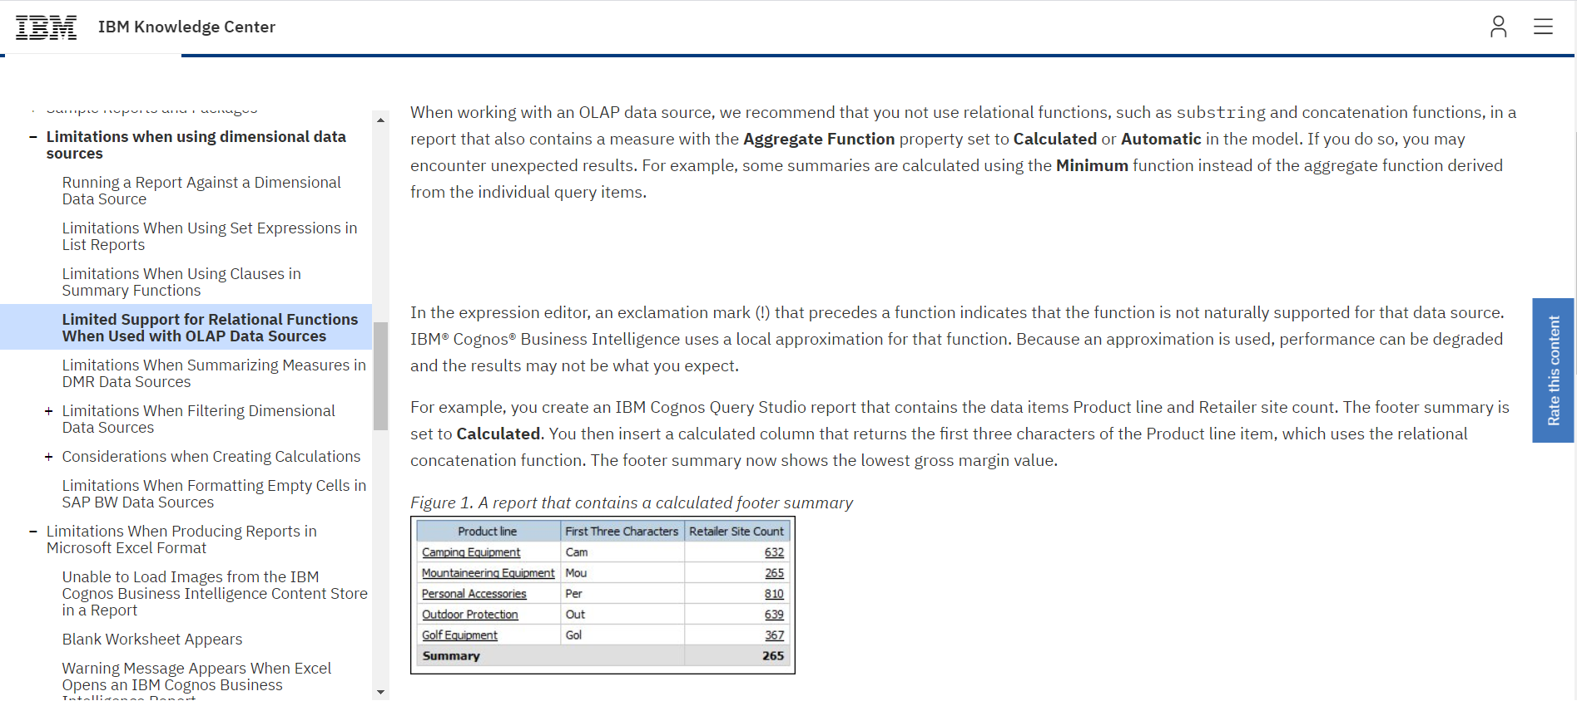

Slide 15

Sisense overview
Sisense is an analytical reporting cloud technology
An end-to-end data analytics platform that makes data discovery and intelligence accessible to everyone via an embeddable, scalable architecture.
On the front-end, users of all technical skill levels can craft visualizations, reports and dashboards to explore and share insights that drive businesses forward.
Back-end powered by in-chip technology
Designed for companies of all sizes, it can be deployed on-premises, as a private cloud-hosted SaaS, as a fully managed SaaS or via a hybrid strategy. .

Slide 16
What can you do with sisense?
Connect to any data source
Embed your analytics anywhere
Customize and extend for a branded experience
Decide with instant insights
Predict insights with advances analytics
Generate insightful answers automatically
Harness data science for all
Extend with actionable applications
Explore and unearth insights with machine language and AL
Centralize and model your data
Mashup and analyze data from anywhere

Slide 17
Sisense Dashboard functions
Create a new Elasticcube schema
Connect to source data
Join different data sources
Add data visualization widget
Pivot table
Build settings to import data
Connect to live data
Create a data model
Join data
Update connectivity settings

Slide 18
Criterion: cube- ELASTICUBE MODEL
Benefits
Instant query response times
Creation of complicated star/snowflake schemas is not required
ElastiCube provides access to data in any granularity (not merely to aggregated data)
A data warehouse is not required, but easily supported
There are no physical limits to the number of dimensions an ElastiCube can hold
An ElastiCube requires significantly less powerful hardware than a similar OLAP cube
Changes to ElastiCubes can be done without re-building the entire data model
The ElastiCube is a unique, high-performance analytics database with super-fast data stores that are specifically designed to withstand extensive querying typically required by business intelligence applications.
Data can be accessed from multiple sources, and then merged, manipulated and queried as if it was one consolidated data set.
ElastiCubes perform so well, that in most cases the creation of dedicated OLAP cubes and/or optimized data marts are completely unnecessary – even when dealing with hundreds of millions of rows of raw data.

Slide 19
Criterion: cube – LIVE MODEL
Having the right data available at the right time is critical to making smart business decisions. To ensure that you have the latest data available, Sisense provides live connections to some of the most popular data sources. Sisense Live Connect queries are run directly against the data source. Sisense performs no additional caching on the data.
With live connections, you can refresh your dashboards manually or set them to refresh automatically every few seconds.

Slide 20

Criterion: Query & Storage Performance
The query performance which is the dashboard performance is the amount of time it takes to load a Sisense dashboard.
Query return time on Sisense is quick with a minimum return time of 0.1s and maximum return time of 3.1s.
CPU is low and its usage during any load test is approximated at 10-20%.

Slide 21
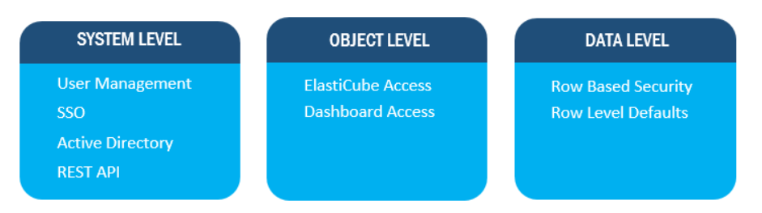
Criterion Security

Slide 22
Criterion: COST OF OWNERSHIP
Licensing costs:
License/Subscription Cost – Basic/Business/Business+
Maintenance Cost
Installation/Implementation Cost
Customization Cost
Data Migration Cost/Change Management/Upfront Switching Cost
Recurring/Renewal Costs
Implementation:
The solution can be implemented in the short span of time, as there are not additional hardware and software to setup.

Slide 23
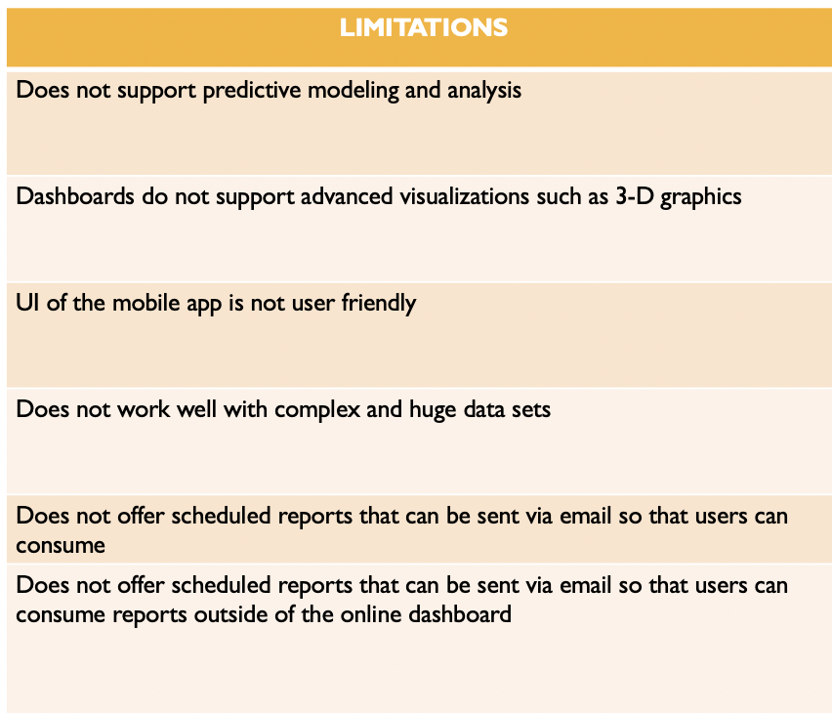
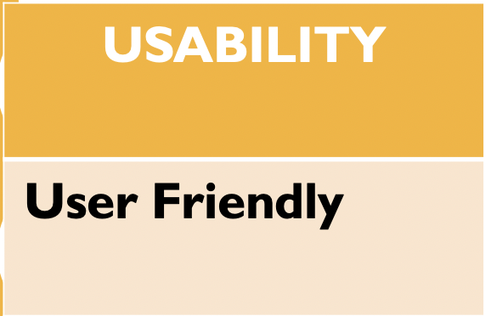
Criterion: Usability & LIMITATIONS
Accessible via its web application which runs on most web browsers/ mobile devices | Available on Linux

Slide 24
Comparative summary
 | IBM COGNOS | SISENSE
How the tool deals with multidimensional dataset "Cube" or data in General. | Can support MOLAP , ROLAP and HOLAP ✅ Data is stored in both multidimensional and relational database(RDMS),columns, rows, tables and data cubes. It has ETL tool called decision stream. Examples of RDMS supported by COGNOS are IBM DB2, Microsoft SQL Server, and Oracle. | Act as Dynamic cubes so it supports ROLAP. It uses in-chip technology called ELASTICUBES. It stores data in Columnar Database Management System (CDBMS) which is also a function ROLAP. ROLAP stores data in columns, rows and tables. It has an integrated database, extract/transform/load (ETL) modality, analytics and visualization tool functions. Supports DBMS like MYSQL, SQL Server, Oracle and Access. All store tabular data row-by-row
Query performance | Users can fine tune tuning performances however this will vary depending on the operating system such as UNIX and Windows. Query response time is slow | ElastiCubes do not require pre-aggregations and/or creation of indexes. It has been designed to use both as efficiently and speedily as possible by default. ✅ For a standard query, query return time on Sisense is quick with a minimum return time of 0.1s and maximum return time of 3.1s. ✅

Slide 25
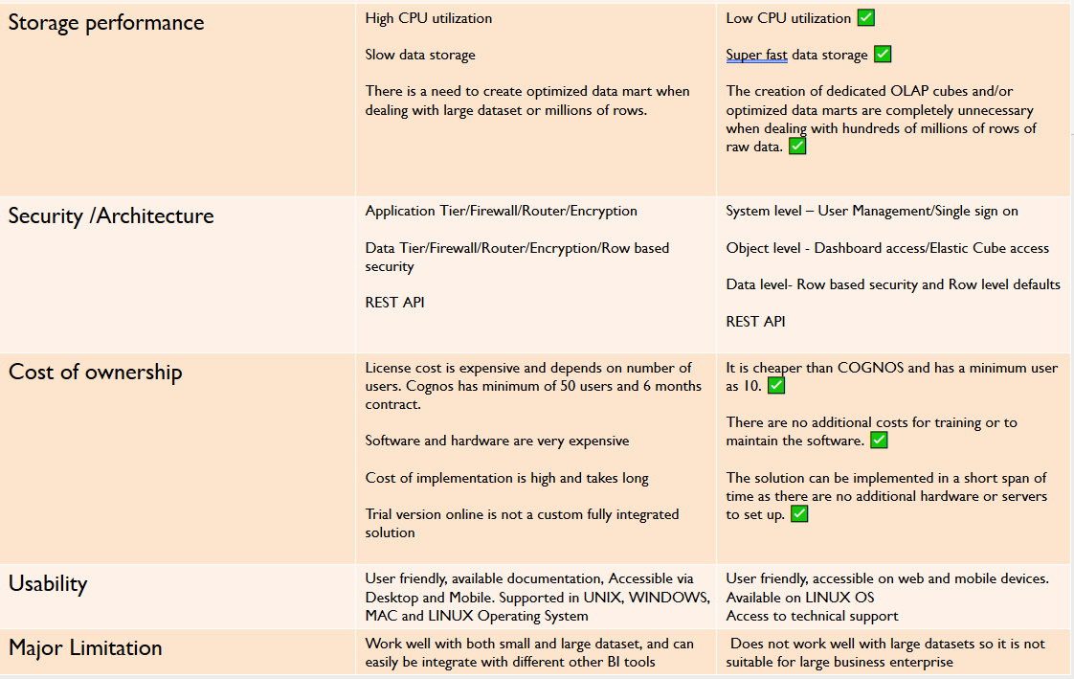
Comparison contd.

Slide 26
Conclusion
After a meticulous evaluation of both IBM Cognos HOLAP tailored solution and Sisense, based on the selected criteria shown in the comparative summary analysis, we firmly believe that Sisense would be an optimum solution for small to medium size companies. Whereas, Cognos Hybrid Online Analytical custom solution would be an optimum solution for medium to large sized size organizations. This conclusion is partly derived from the fact that IBM Cognos licensing requires a minimum of 50 users. Whereas, Sisense offers individual licensing plan. Finally, detailed comparison of both tools shown in the summary table backup our assertion.

Slide 27
References:
https://www.ibm.com/support/knowledgecenter/SSEPGG_10.5.0/com.ibm.dwe.cubeserv.doc/topics/olap_and_cubing_container.html?view=embed ==>ABOUT CUBE
https://documentation.sisense.com/latest/managing-data/ElastiCubes.htm#gsc.tab=0 ==> Sisense Cube
https://www.ibm.com/support/knowledgecenter/en/SSEP7J_10.2.2/com.ibm.swg.ba.cognos.wig_cr.10.2.2.doc/c_gtstd_c8_bi.html ==> overview IBM C
https://support.sisense.com/hc/en-us/articles/115007184947-Sisense-Performance-A-Billion-Records-in-a-Single-Server ==> performance (element of answer)
https://support.sisense.com/hc/en-us/articles/230649448-Maximize-Dashboard-Performance
https://documentation.sisense.com/latest/administration/defining-security-and-access-settings/security-overview.htm#gsc.tab=0 ==> Sisense security
https://www.ibm.com/support/knowledgecenter/en/SSEP7J_10.2.1/com.ibm.swg.ba.cognos.ug_cra.10.2.1.doc/c_systemperformancemetrics.html#SystemPerformanceMetrics ==> Managing performance
https://www.ibm.com/support/knowledgecenter/SSEP7J_11.0.0/com.ibm.swg.ba.cognos.ug_cra.doc/c_tuning_server_performance.html ==> IBM Cognos performance
https://www.ibm.com/support/knowledgecenter/en/SSPN2D_10.2.1/com.ibm.swg.im.cognos.contrib_admin.10.2.1.doc/contrib_admin_id20068contr_LimitsImprtPkgs.html ===> Limitation of Cogno
https://www.ibm.com/support/knowledgecenter/SSNW2F_5.5.0/com.ibm.p8.pa.user.doc/bpfpa021.htm

Slide 28
Thank you
Sango Fon (sango.fon@cgu.edu)

